Slide 1
RESTFul API's do 0 à Nuvem Com ASP.NET Core 2.0 e Docker

Slide 2
Seção 02: Fundamentos Teóricos Do REST

Slide 3
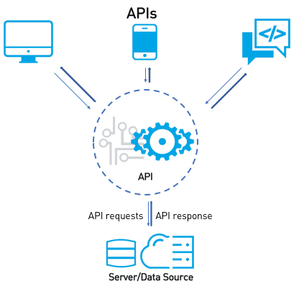

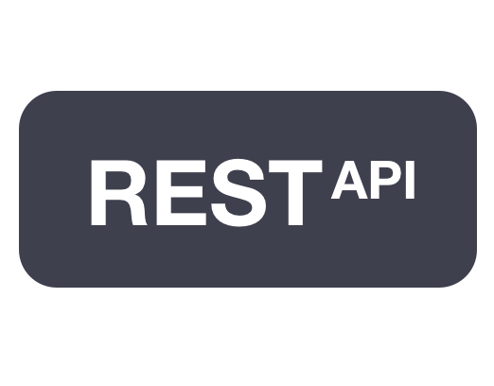




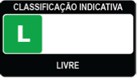

Slide 4
Seção 03: Configuração Do Ambiente No Windows

Slide 5








Slide 6
Seção 04: Configuração Do Ambiente No Linux

Slide 7





Slide 8
Seção 05: Primeiros Passos

Slide 9




Slide 10
Seção 06: Implementando Uma Calculadora

Slide 11


Slide 12
Seção 07: Aprendendo Os Quatro Verbos Principais

Slide 13


Slide 14
Seção 08: Integrando A Aplicação Ao Banco De Dados

Slide 15

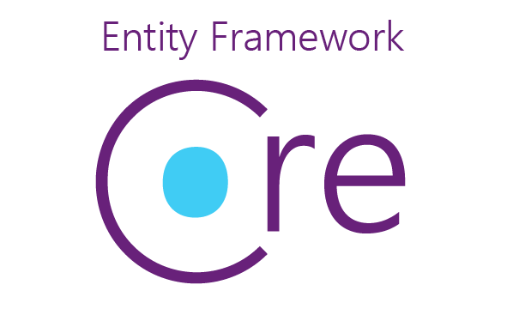



Slide 16
Seção 09: Versionamento Da Nossa API

Slide 17
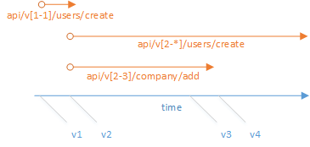

Slide 18
Referências
https://msdn.microsoft.com/en-us/library/ff384251.aspx
https://nordicapis.com/introduction-to-api-versioning-best-practices/
http://www.patrickniezen.com/2016/2/11/api-versioning-with-mvc-6
https://www.troyhunt.com/your-api-versioning-is-wrong-which-is/
https://www.youtube.com/watch?v=55oIJuMUnDc

Slide 19
Aplicação Multicamadas

Slide 20
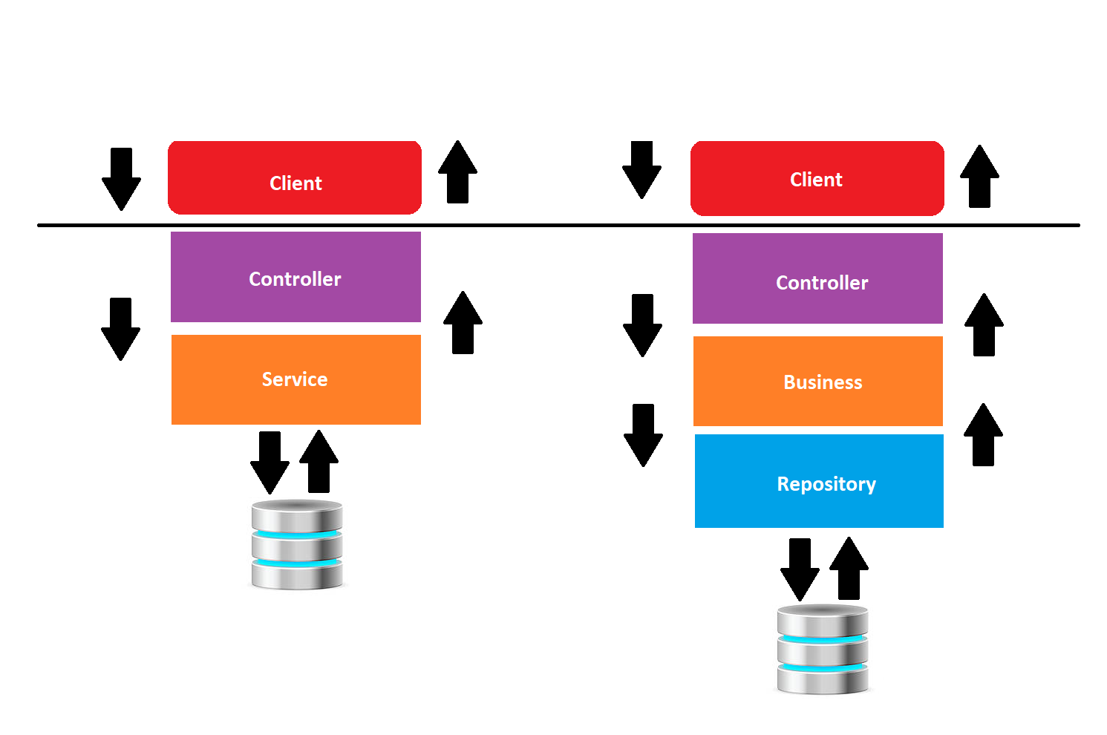

Slide 21
Referências
https://martinfowler.com/bliki/PresentationDomainDataLayering.html
https://msdn.microsoft.com/en-us/library/ee658109.aspx
https://msdn.microsoft.com/en-us/library/ff648105.aspx
https://en.wikipedia.org/wiki/Multitier_architecture
https://www.linkedin.com/learning/practical-application-architecture-with-entity-framework-core/multi-layer-applications

Slide 22
O Padrão de Projetos Repository

Slide 23
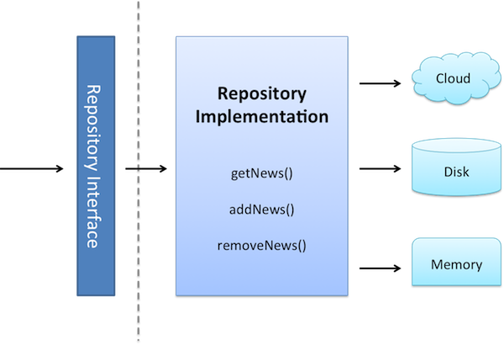

Slide 24
Generic Repository

Slide 25
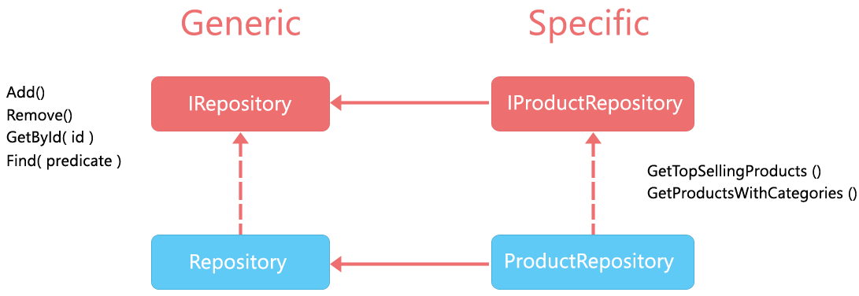

Slide 26
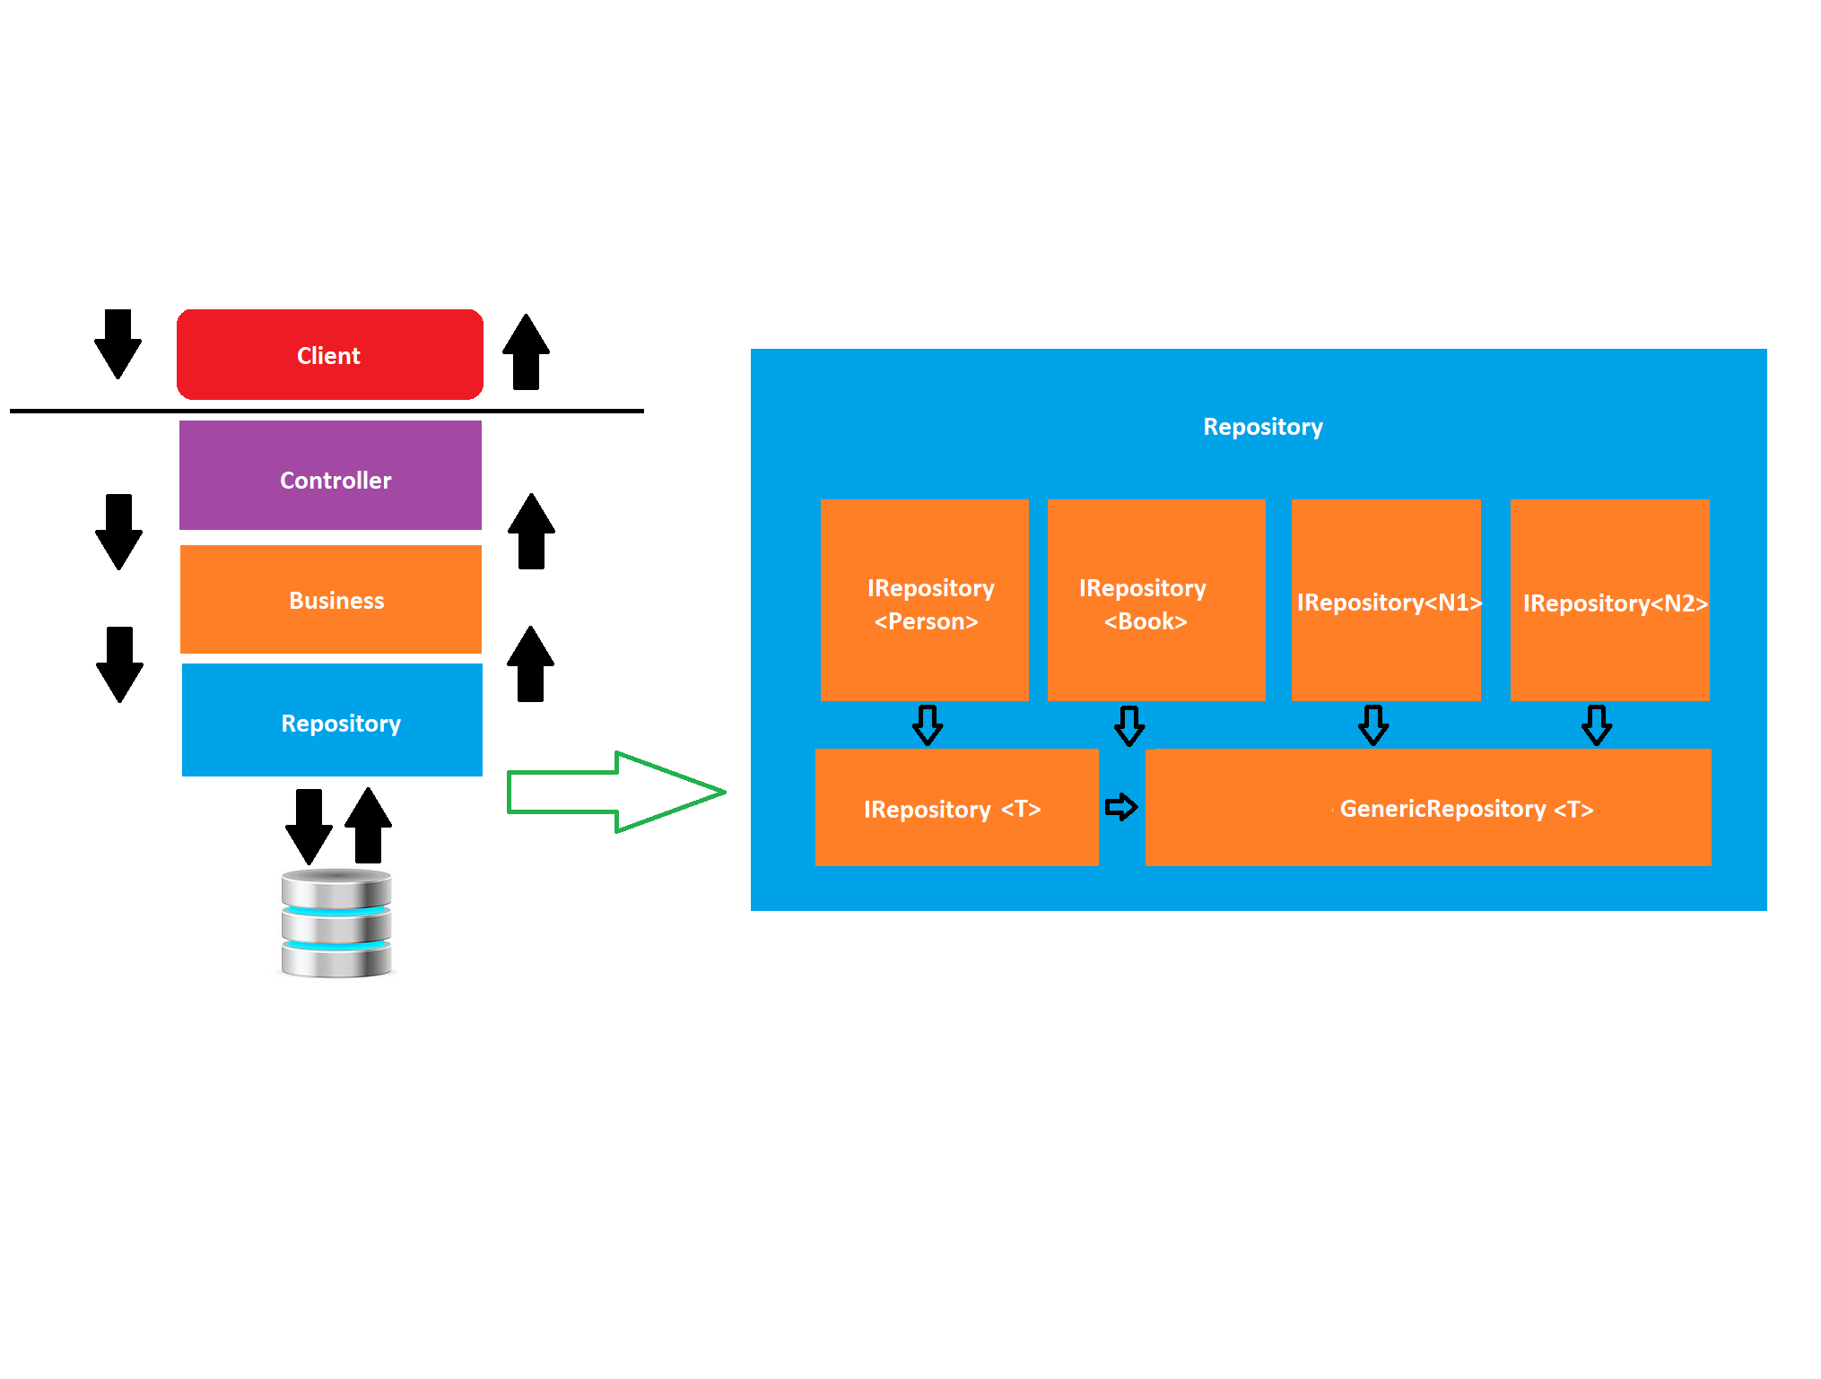

Slide 27
Referências
http://www.dotnetcurry.com/aspnet-mvc/1155/aspnet-mvc-repository-pattern-perform-database-operations
https://www.c-sharpcorner.com/UploadFile/8a67c0/repository-pattern-and-generic-repository-pattern/
http://www.tugberkugurlu.com/archive/generic-repository-pattern-entity-framework-asp-net-mvc-and-unit-testing-triangle
https://www.codeproject.com/Articles/814768/CRUD-Operations-Using-the-Generic-Repository-Patte
http://hannesdorfmann.com/android/evolution-of-the-repository-pattern

Slide 28
O Padrão de Projetos Value Object - VO

Slide 29
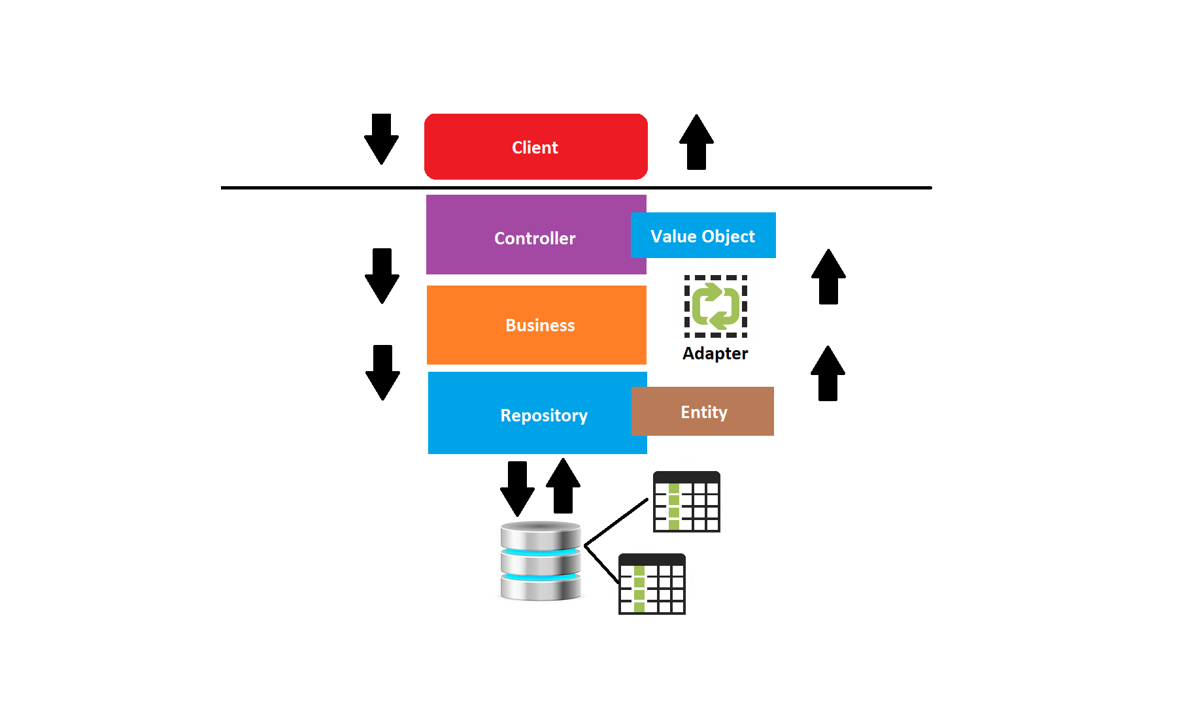

Slide 30
Referências
https://martinfowler.com/bliki/ValueObject.html
https://www.codeadventure.com/blog/why-you-should-use-value-objects
https://www.devmedia.com.br/diferenca-entre-os-patterns-po-pojo-bo-dto-e-vo/28162
https://imasters.com.br/artigo/7293/linguagens/padroes-de-projeto-value-object?trace=1519021197
[Generic Repository and Unit of Work Pattern, Entity Framework, Unit Testing, Autofac IoC Container and ASP.NET MVC](https://techbrij.com/generic-repository-unit-of-work-entity-framework-unit-testing-asp-net-mvc)
[HATEOAS](https://shatzisblog.wordpress.com/2017/09/01/generating-hypermedia-links-for-an-asp-net-core-web-api/)
[Pragmatic REST: APIs without hypermedia and HATEOAS](http://www.ben-morris.com/pragmatic-rest-apis-without-hypermedia-and-hateoas/)

